Slide 1

Unemployment in India
01

Slide 2

Various practices of solving problem.
(The CPI strategy employed / matching)
01
02
03
Find the questions
Search the space
Transform the problem

Slide 3


Importance of asking question
Asking the right question is the most important thing. Questioning the society can lead to solution to the problems and revolutions.
03

Slide 4



The First Practice of Asking: Find the Question
What causes Unemployment?
What is
Unemployment?
What is Frictional & Structural Unemployment?
Demand-side reductions may be caused by high interest rates, global recession, and monetary crisis. From the supply side, frictional unemployment and structural employment play a significant role.
The term unemployment refers to a situation when a person who is actively searching for employment is unable to find work.
Frictional unemployment refers to those workers who are in between jobs. Structural unemployment happens when the skills set of a worker does not match the skills needed by the jobs available.
04

Slide 5
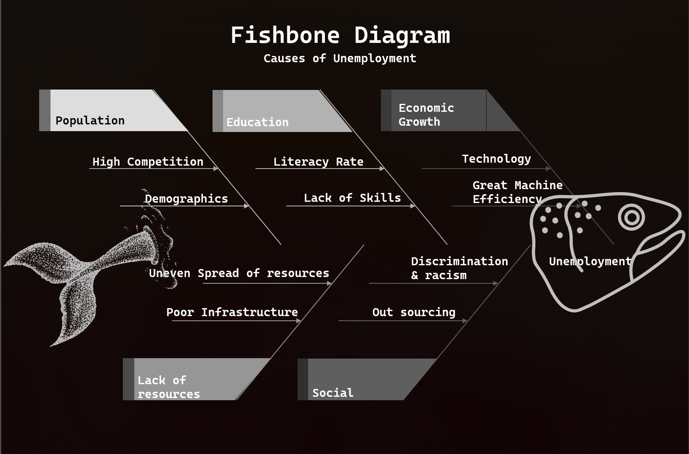
Practice of Asking: Search the space
05

Slide 6
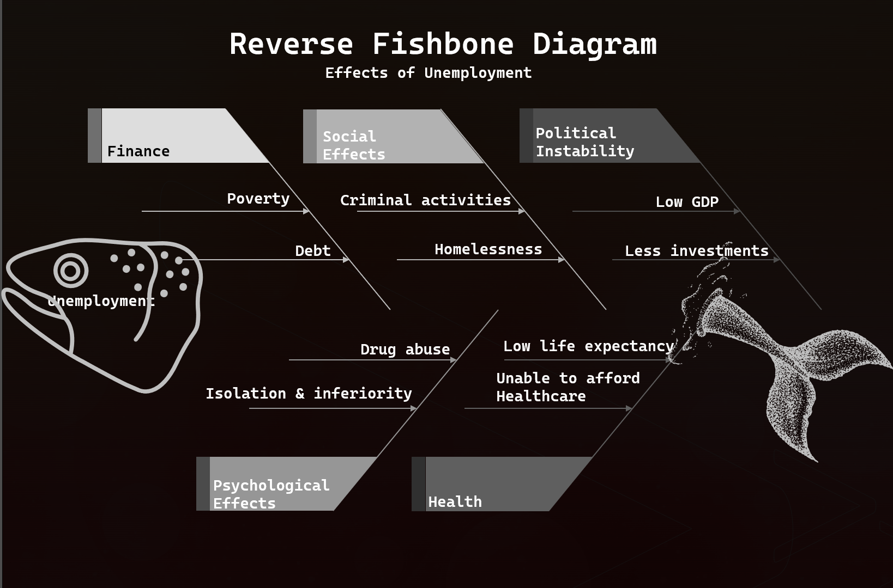
Practice of Asking: Transform the problem
06

Slide 7

Change in industrial technique
Production technique should suit the needs and means of the country. It is essential that labour intensive technology should be encouraged in place of capital-intensive technology.
TRANSFORM THE PROBLEM TO THE SOLUTION
Increase
in Production
To increase employment, it is essential to increase production in agriculture and industrial sectors. Development of small and cottage industries should be encouraged.
More importance
to employment programmes
In five year plans more importance should be given to employment. The programmes like irrigation, roads, flood control, power, agriculture, rural electrification can provide better employment to people.
07

Slide 8


More Solutions
More assistance to self-employed people
Population control
Expansion of Employment exchanges
The growth of population should be checked to solve unemployment, problem. Family planning programme should be implemented widely and effectively.
Most people in India are self-employed. They are engaged in agriculture, trade, cottage, and small-scale industries etc. These persons should be helped financially, providing raw materials and technical training.
More employment exchanges should be opened. Information regarding employment opportunities should be given to people.
06

Slide 9



Conclusion
Unemployment is a serious and an important challenge which needs to be looked and removed from the country. As we know, in country like India, Unemployment is one of the biggest challenges. Government should implement job opportunities for the young youth who are willing to work. Plus, there should be more job opportunities in the rural areas too and a system of giving opportunity of interview. Courses should be arranged for the youth to motivate even if they are not employed. Individuals must take initiative steps in increasing the productivity and improving the standard of living.
10

Slide 10



References
Team Members
Economics Discussion
https://www.economicsdiscussion.net/
Investopedia
https://www.investopedia.com/
Daksh Dadhania
(210911072)
Sneagen Jai B
(210907302)
Economics Help
https://www.economicshelp.org/
11
Vaibhav Narang
(121002039)
Ishaan Agarwal
(210905184)

